Slide 1
B-2.6 Summarize the characteristics of the cell cycle: interphase (called G1, S, G2); the phases of mitosis (called prophase, metaphase, anaphase, and telophase); and plant and animal cytokinesis.
The cell cycle is a repeated pattern of growth and division that occurs in eukaryotic cells.
This cycle consists of three phases: G1, S, G2
The first phase represents cell growth while the last two phases represent cell division.

Slide 2
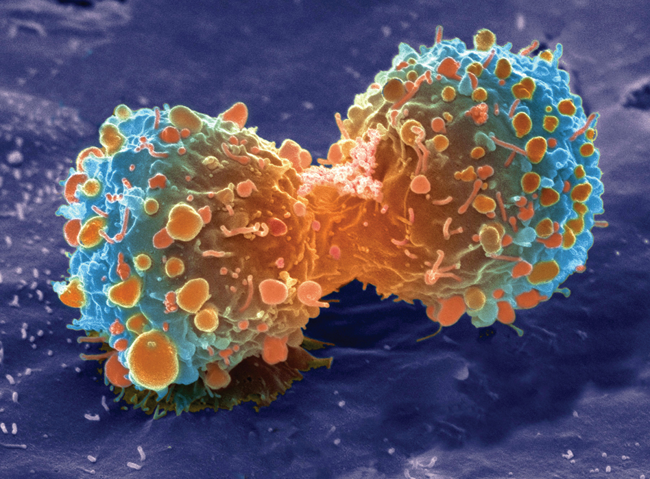
KEY CONCEPT
Cells have distinct phases of growth, reproduction, and normal functions.

Slide 3
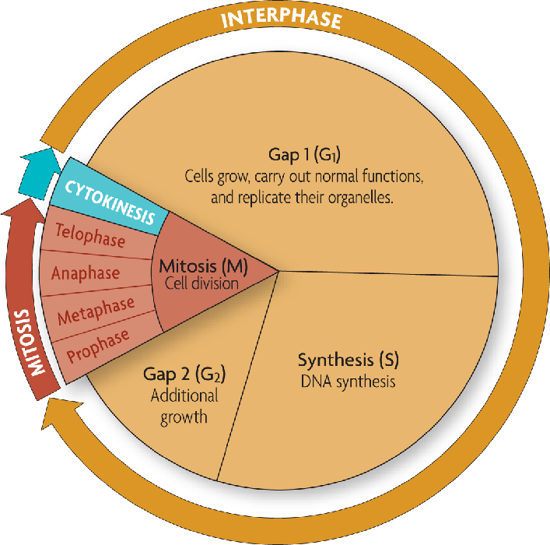

The cell cycle has four main stages.
The cell cycle is a regular pattern of growth, DNA replication, and cell division.

Slide 4
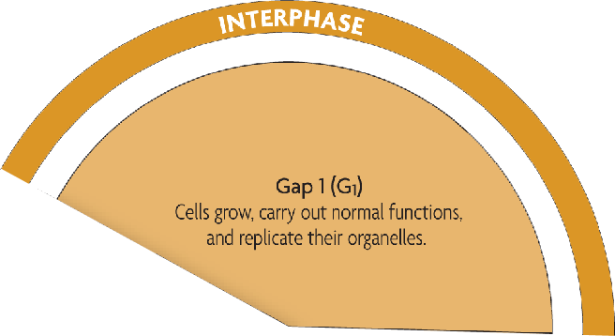
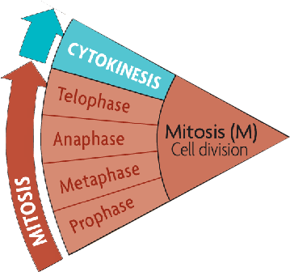
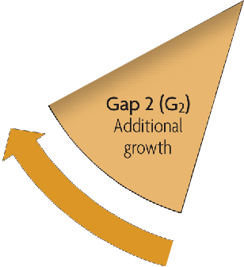
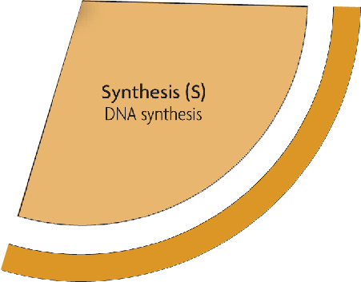
The main stages of the cell cycle are gap 1, synthesis, gap 2, and mitosis.
  Gap 1 (G₁): cell growth and normal functions
  DNA synthesis (S): copies DNA
  Gap 2 (G₂): additional growth (chromatids become replicated chromosomes)
  Mitosis (M): includes division of the cell nucleus (mitosis) and division of the cell cytoplasm (cytokinesis)
Mitosis occurs only if the cell is large enough and the DNA undamaged.

Slide 5
Interphase
Cells spend the majority of their cell cycle in interphase.
The purpose of interphase is for cell growth.
By the end of interphase a cell has two full sets of DNA (chromosomes) and is large enough to begin the division process.

Slide 6
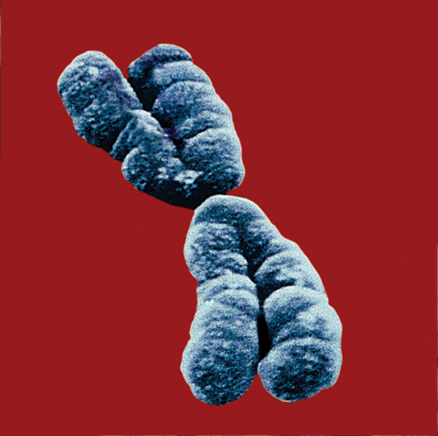
Sister chromatids
How does 6.5 feet of DNA condense into a chromosome?

Slide 7
Materials:
Capsule- nucleus
String – DNA
Objective:
With your group, figure out a way to fit all of the DNA into the nucleus. You may use various tools, but ALL DNA needs to fit into the closed nucleus.
Show me when you are done! ☺

Slide 8
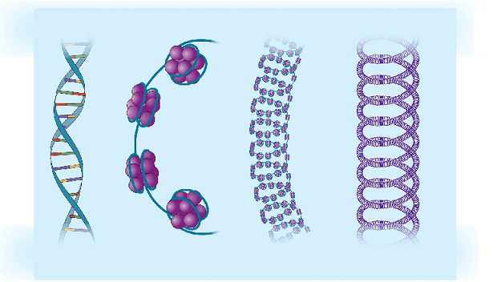
Chromosomes condense at the start of mitosis.
DNA wraps around proteins (histones) that condense it.
Ina typical human cell, there is about 6.5 feet of DNA!
DNA double
helix
DNA and
histones
Chromatin
Supercoiled
DNA

Slide 9
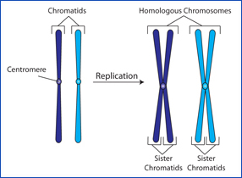

Slide 10
Mitosis
The purpose of mitosis is cell division: making two cells out of one.
Each cell has to have its own cytoplasm and DNA.
The DNA is replicated in interphase when two chromosome strands became four strands (two strands per chromatid).
In mitosis the four strands (two sister chromatid) have to break apart so that each new cell only has one double-stranded chromosome.
Two sister chromatids together make a chromosome

Slide 11
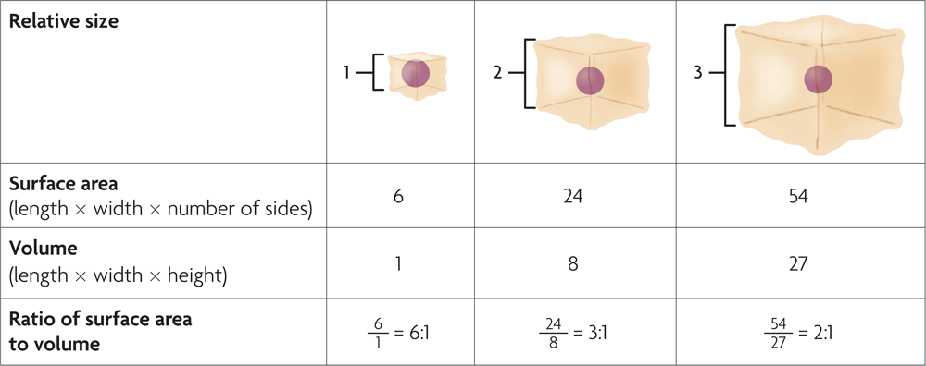
Cell size is limited.
Volume increases faster than surface area.

Slide 12
Prophase is characterized by four events:
  Chromosomes condense and are more visible.
  The nuclear membrane (envelope) disappears.
  Centrioles have separated and taken positions on the opposite poles of the cell.
  Spindle fibers form and radiate toward the center of the cell.

Slide 13
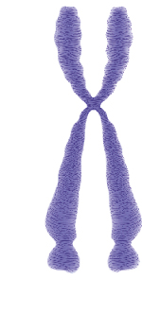
DNA plus proteins is called chromatin.
telomere
chromatid
One half of a duplicated chromosome is a chromatid.
Sister chromatids are held together at the centromere.
Telomeres protect DNA and do not include genes.
https://www.youtube.com/watch?v=x1zw6uRxKYU telomeres and aging
centromere
telomere
Condensed, duplicated chromosome

Slide 14
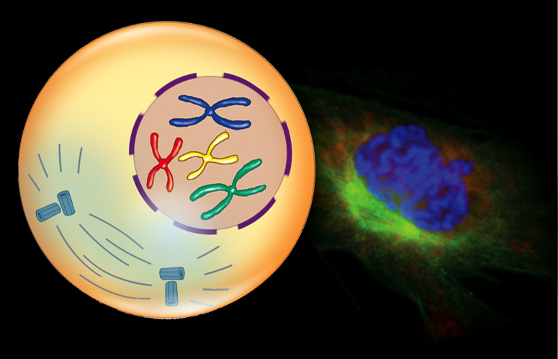
Mitosis divides the cell’s nucleus in four phases.
  During prophase, chromosomes condense and spindle fibers form.

Slide 15
Metaphase (the shortest phase of mitosis) is characterized by two events:
  Chromosomes line up across the middle of the cell.
  Spindle fibers connect the centromere of each sister chromatid to the poles of the cell.

Slide 16
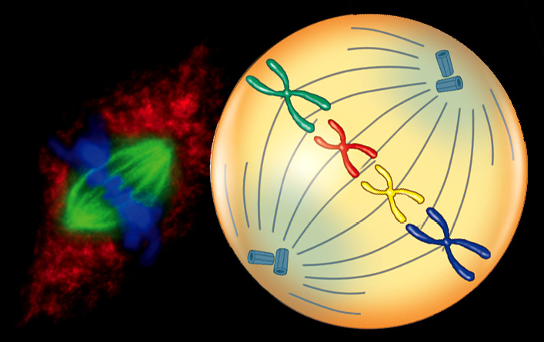
Mitosis divides the cell’s nucleus in four phases.
  During metaphase, chromosomes line up in the middle of the cell.

Slide 17
Anaphase is characterized by three events:
  Centromeres that join the sister chromatids split.
  Sister chromatids separate becoming individual chromosomes.
  Separated chromatids move to opposite poles of the cell.

Slide 18
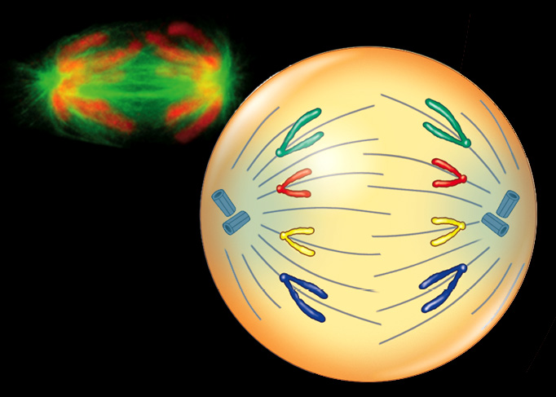
Mitosis divides the cell’s nucleus in four phases.
  During anaphase, sister chromatids separate to opposite sides of the cell.

Slide 19
Telophase (the last phase of mitosis) consists of four events:
  Chromosomes (each consisting of a single chromatid) uncoil.
  A nuclear envelope forms around the chromosomes at each pole of the cell.
  Spindle fibers break down and dissolve.
  Cytokinesis begins.

Slide 20
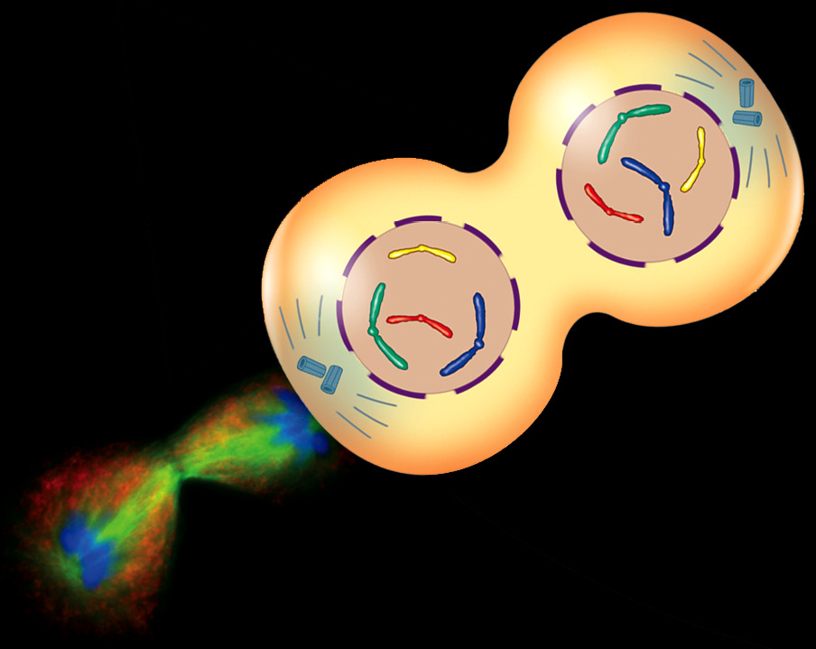
Mitosis divides the cell’s nucleus in four phases.
  During telophase, the new nuclei form and chromosomes begin to uncoil.

Slide 21
Cytokinesis
Cytokinesis is the division of the cytoplasm into two individual cells.
The process of cytokinesis differs somewhat in plant and animal cells.
In animal cells the cell membrane forms a cleavage furrow that eventually pinches the cell into two nearly equal parts, each part containing its own nucleus and cytoplasmic organelles.

Slide 22
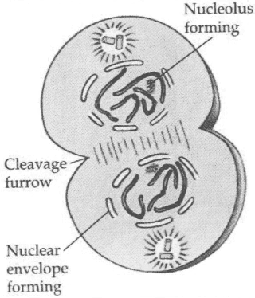
Animal Cell Telophase/Cytokinesis

Slide 23
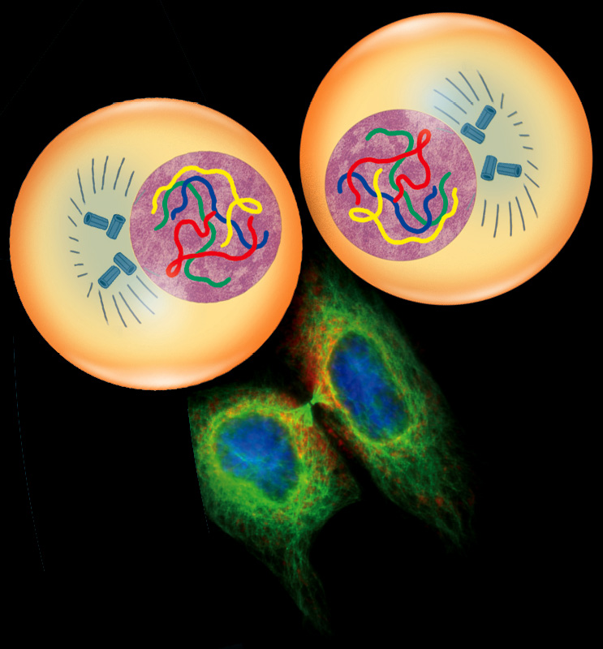
Cytokinesis differs in animal and plant cells.
  In animal cells, the membrane pinches closed.
  In plant cells, a
  cell plate forms.

Slide 24
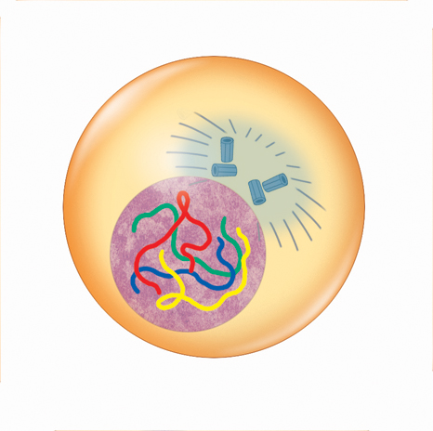
Mitosis and cytokinesis produce two genetically identical daughter cells.
Parent cell
Interphase prepares the cell to divide.
During interphase, the DNA is duplicated.
centrioles
spindle fibers
centrosome
nucleus with
DNA

Slide 25
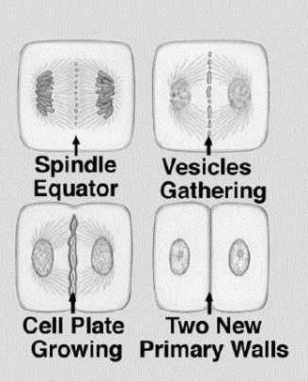
Plant Cell Telophase/Cytokinesis

Slide 26
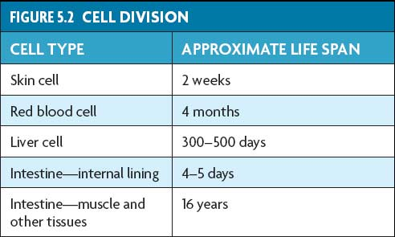
Cells divide at different rates.
The rate of cell division varies with the need for those types of cells.
Some cells are unlikely to divide (G₀).

Slide 27
Diploid
Autosomal cells – body cells or any non- sex cell.
A cell that contains 2 sets of chromosomes.
-The number is represented as 2n (n= number of chromosomes)
Humans have 2 sets of 23 chromosomes for a total of 46 chromosomes. 2n or 2(23)=46

Slide 28
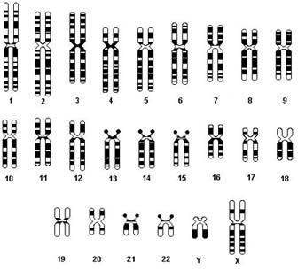
Somatic Cells
In any given somatic cell there are 22 pairs of regular chromosomes and 1 pair of sex chromosomes.

Slide 29
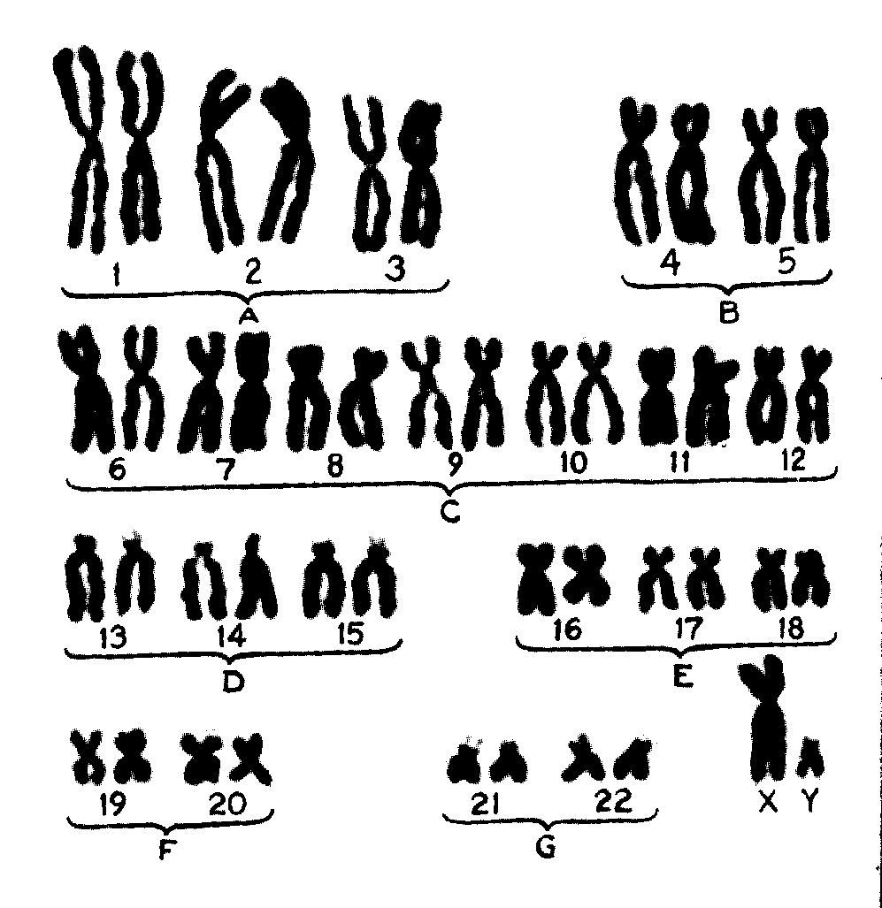
Karyotype – the number and appearance of chromosomes
What do you notice about the…
  Size
  Centromere
  Telomere
  Sex
  Number
  Homologous pair:
  Why are there 2 of each chromosome?

Slide 30
Homologous chromosomes are two chromosomes that are the same. This happens because diploid organisms have two of each chromosome. Each of the pairs is a homologous pair. One of the homologous chromosomes was inherited from the individual's mother and the other one was inherited from the individual's father. For example, the two chromosomes #1 are homologous. However, a chromosome #1 and a chromosome #2 are not homologous because they are different chromosomes.

Slide 31

